Slide 1
WCO · OWNED BRANDS · DATAVERS BRIEF
The signals to help WCO sellers win deals
and hold owned-brand margin.
A read-only, vendor-side intelligence and activity platform inside WCO. It surfaces the signals and tracks our engagement, so the Owned Brands team shows up at the right time with the right pitch.
surface signal → reach the right seller → win & hold margin → growth
Jeff Goodman · Director, Sales, Owned Brands · June 19, 2026 · Status: Discovery / prototype

Slide 2
WHO WE ARE, AND WHAT’S MISSING
We can’t see the signals that win deals and hold margin
◉
⚑
▤
We’re the vendor team
We fly blind
We have no tools of our own
WCO is our primary customer. The Owned Brands team calls on WCO sellers and select customers to help them win with owned brands.
We don’t see which sellers are about to lose a winnable deal, or where competitive pressure is eroding owned-brand margin.
WCO’s systems (CORE, USD) weren’t built for the vendor lens. OB-specific tools would lift win rate and margin org-wide.
The platform’s job: surface those signals and put us in the right place at the right time.
Owned Brands Sales Intelligence Platform · Confidential / Internal · 2 / 10

Slide 3
IN PRACTICE
A deal we’d lose today, and how we win it
→
→
The deal
The threat
How we win
A WCO seller is bidding a security project: a national-brand camera line, with the rest of the bill of materials still open. The seller sourced it and holds registered project pricing on the cameras.
A competing distributor bids the same cameras, but pairs them with its own-brand cable. The extra margin on that cable lets it beat our total price, registered pricing and all.
The platform flags this seller. The OB team helps specify Owned Brands into the bill of materials, lifting margin and sharpening total price, so WCO keeps the deal.
Today no system surfaces this seller in time. That is the gap, and the whole point of the platform.
Owned Brands Sales Intelligence Platform · Confidential / Internal · 3 / 10

Slide 4
THE ENGINE, OUR NORTH STAR
One loop puts us in the right deal at the right time
→
→
→
1
2
3
4
Surface
Reach
Win
Grow
Signal in the governed data: a deal at risk or margin under pressure
The right WCO seller or customer, at the right time, with the cross and context
Help close the deal and hold owned-brand margin
Owned brands grow; the engagement is tracked
The SKU is the spine. One detail view unifies sales, stock, opportunities, crosses, and activity. Two tiers run the model: the WCO seller channel (push) and WCO customers (pull).
Owned Brands Sales Intelligence Platform · Confidential / Internal · 4 / 10

Slide 5
WHAT YOU GET
A vendor-side platform and CRM, already prototyped
⇄
Cross database
◎
Signals + supply
☷
Vendor-lens CRM
Competitive product to owned-brand mapping. OB enablement, not org-wide access.
Where to show up: deals at risk, margin under pressure, stock signal.
OB-generated opportunities; engagement with WCO sellers, our customer (not in USD).
✉
AI email-drop
▣
Leadership dashboard
▤
Inventory & forecast
A note to records; opportunity-loss and product-development signals.
Natural-language query over the whole pipeline.
Stock overlay with pipeline-weighted demand.
Built read-only and in-tenant. Margin/cost confined to the authorized OB group.
Owned Brands Sales Intelligence Platform · Confidential / Internal · 5 / 10

Slide 6
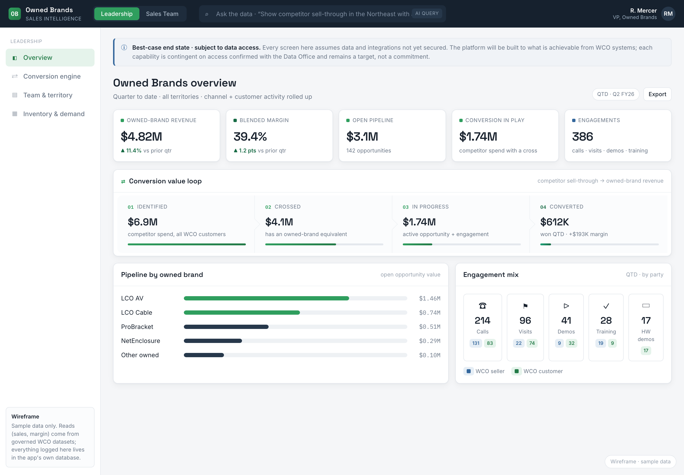
PROOF
Already built: the leadership view
1
Conversion value loop
Identified → crossed → in progress → converted, tracked live.
2
Pipeline by owned brand
LCO AV, LCO Cable and more, ranked by open opportunity.
3
Engagement by party
Calls, visits, demos logged for the WCO seller and customer.
Working two-persona wireframe (Leadership + Sales Team); sample data only. This is proven UX, not a concept.
Owned Brands Sales Intelligence Platform · Confidential / Internal · 6 / 10

Slide 7
WHY NOW
The team is built to execute. The tool is the missing piece.
We just integrated the LCO sales organization, adding capability and aligning structure to the Owned Brands mandate inside WCO. The structure is in place; the missing piece is the toolset that lets it see around corners that are blind today.
FIRST 90 DAYS
30
Equip the team now and that structural investment compounds. Wait, and winnable deals like the one we just walked through keep slipping, quietly.
opportunities WCO would otherwise have lost, identified and supported.
Owned Brands Sales Intelligence Platform · Confidential / Internal · 7 / 10

Slide 8
ARCHITECTURE & GOVERNANCE
Read-only in, governed all the way through, the win out
→
→
→
WCO sources
Governed access
OB_Datavers
Dashboard, then the win
CORE (ERP)
USD (CRM)
Inventory
Certified datasets,
Power BI, or the
enterprise API layer
Cross-reference engine
Activity store, Azure SQL
AI layer, Azure OpenAI
Embedded Power BI
Seller signals surfaced
Spec owned brands, win
systems of record
read-only
isolated, in-tenant
Entra ID SSO · RBAC + row-level security · stays inside the Microsoft / Azure boundary, no egress
Not doing: no writes to CORE/USD, no direct DB connectivity, no duplication, no access outside OB, no egress.
Proposed and aligned to confirmed WCO Azure standards; the exact governed-data mechanism is confirmed with the Data Office before build.
Owned Brands Sales Intelligence Platform · Confidential / Internal · 8 / 10

Slide 9
THE PLAN
A phased build I can execute solo
0
1
2
3
4
Now
Access
Build
AI
Rollout
Scoping, prototype, access one-pager, systems discovery
Secure read-only approval; confirm mechanism with Data Office
Azure production: data layer, app DB, identity, Power BI
Email-drop, datasheet crosses, natural-language query
Team adoption, education & sales-plan outputs
Phased by design: each phase is independently valuable and lowers the risk of the next.
Owned Brands Sales Intelligence Platform · Confidential / Internal · 9 / 10

Slide 10
THE ASK
Approve read-only access, an Azure environment, and governance liaisons
1
Read-only data access
Governed WCO sales data incl. margin/cost, via certified datasets, Power BI, or the API layer. User group: the Owned Brands sales team only. No access provided outside of OB.
2
Azure build environment
Subscription / resource group under WCO governance, Entra ID app registration, Azure OpenAI in-tenant, and a Power BI workspace with certified-dataset read access.
3
Governance liaisons
Named contacts from Data Office, BI Governance, Cloud Engineering, and IT Security, plus confirmation of the access-request workflow and margin/cost classification.
Not requested: writes to CORE/USD, direct DB connectivity, data duplication, access outside OB, or any egress.
Approve these and the Owned Brands team can finally see the signals and act on them.

